Slide 1

ECO & SCO
Economic Corporation Organization(ECO)
Shanghai Cooperation Organization (SCO)

Slide 2
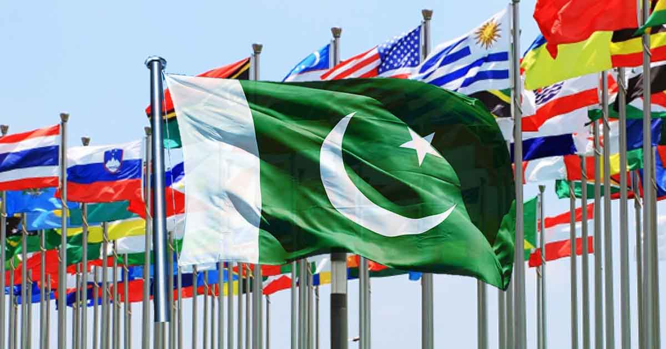
Key Points of ECO
Key Points of SCO
Introduction
Background
Structure
Objectives
Areas of Cooperation
Role of Pakistan in ECO
Challenges
Introduction
Background
Structure
Objectives
Areas of Cooperation
Role of Pakistan in SCO
Challenges

Slide 3
SCO Background and Formation
Cold war effects
Russian integration
Russian influence and stop America in CA.
China collaborator of Russia since ww2.
Communists' approaches.
Addition of CA countries to make Shanghai five in 1996
Security organization within member states.
June 2001 became SCO.
Uzbekistan joined to become 6.

Slide 4

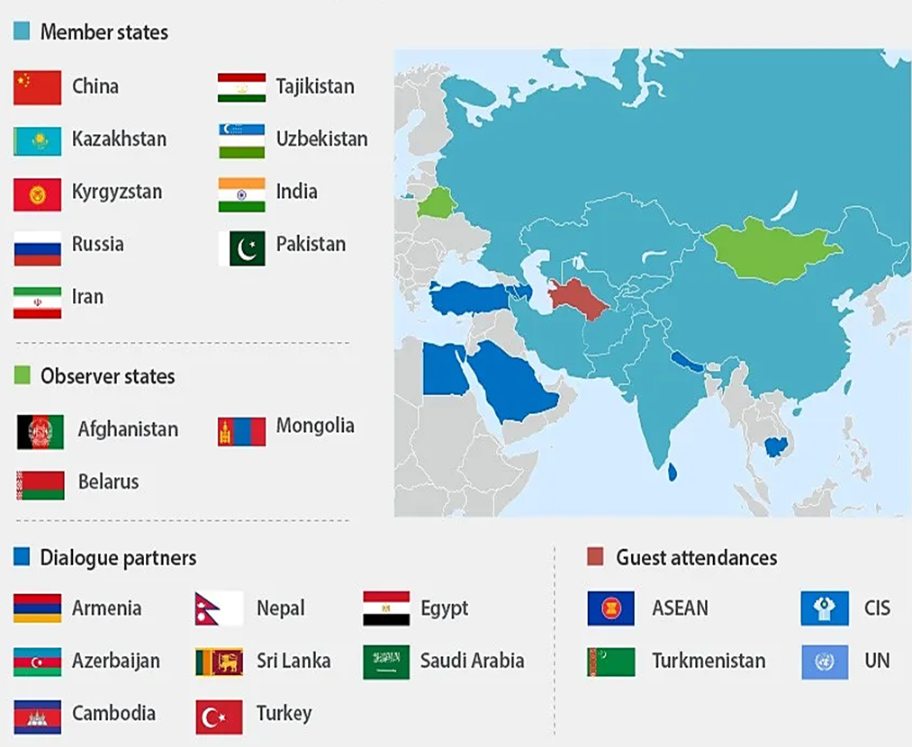

Slide 5
Structure Of SCO
Council of heads of state
Council of prime ministers
Council foreign ministers
RATS
Business council
Consortium bank
Youth council

Slide 6
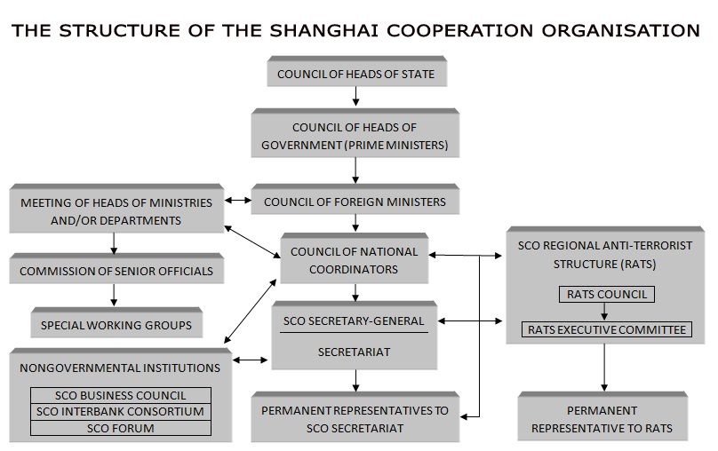

Slide 7

ECO Background and Formation
PRO AMERICAN COUNTRIES
Pak, Turkey and Iran made RCD in 1964.
Economic boost.
Iran revolution in 1979
Russian integration 1981
Inactive 1976.
Renamed ECO in 1985
Addition of CA countries in 1992
Began functioning

Slide 8
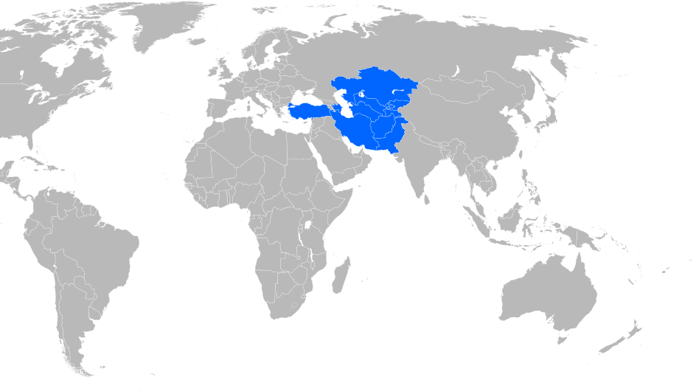

Slide 9
Structure of ECO
Secretariat Gen
Deputy secretaries
Directors
Assistant directors
Junior staff
Decision making
Council of foreign ministers
Permanents ambassadors
Regional planning council

Slide 10
Primary objectives of SCO
Primary objectives of ECO
Promoting Trade and Investment
Enhancing Connectivity and Infrastructure
Financial Cooperation
Addressing Economic Disparities
Collaboration on Innovation and Technology
Energy Cooperation
Security Provision
Protection Against Evils
Trade Facilitation
Infrastructure Development
Energy Cooperation
Industrial Cooperation
Agricultural Cooperation
Science and Technology Collaboration
Human Resource Development
Tourism Promotion
Environmental Sustainability

Slide 11
Summits of SCO
Summits of ECO
Summit 2001
Summit 2004
Summit 2020
Summit 2021
Recent 23rd Summit
Summit (2006 - Baku, Azerbaijan)
Summit (2010 - Istanbul, Turkey)
Summit (2017 - Islamabad, Pakistan)
Most recent was held on 16th ECO Summit – November 9, 2023 -Tashkent

Slide 12
Areas of Corporation (SCO)
Areas of Corporation (ECO)
Counter-Terrorism Cooperation
Security Dialogue and Coordination
Military Exercises
Trade Facilitation
Infrastructure Projects
Investment Promotion
Financial Cooperation
Cultural Diplomacy
Infrastructure Development
Transit Trade
Military Exercises
Energy Infrastructure
Investment Promotion
Financial Cooperation
Food Security
Tourism Infrastructure
Counter-Terrorism

Slide 13
Role of Pakistan in SCO
Role of Pakistan in ECO
Strategic Location
Geographical Importance
Nuclear Power and Military
Influence over Other Muslim Nations
BRI initiative and CPEC
Energy Demands
War against Terrorisms
Founder Member
Geopolitical Significance
Trade and Economic Integration
Connectivity Projects
Cultural Exchange

Slide 14
Challenges
Security-Centric Focus
Geopolitical Complexities
Diverse Political Systems
Security Cooperation Coordination
Economic Diversification
Economic Disparities Among Member Countries
Infrastructure Challenges
Trade Barriers and Regulatory Differences
Conflict and Political Instability
Energy Security and Resource Management

